Slide 1
HTML (HyperText Markup Language)

Slide 2
BRIEFLY ABOUT WHAT WE LEARNED

Slide 3


Slide 4
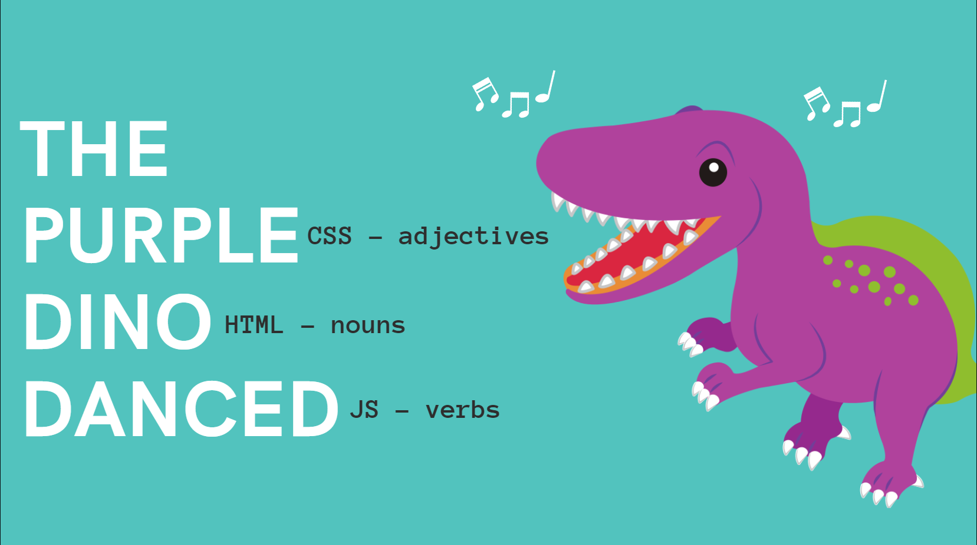

Slide 5

TEXT EDITOR

Slide 6

WORD CAN ALSO BE USED: (not good)

Slide 7
CALCULATOR IN CODEPEN
https://codepen.io/Colt/pen/YzwGmjQ

Slide 8
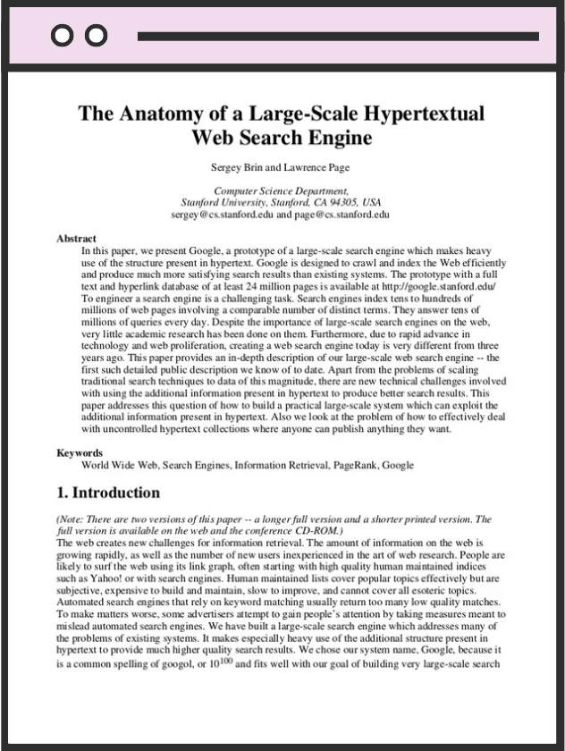
WHY HTML WAS CREATED
How would you describe the structure of this academic research to someone over the phone so that they can reproduce it identically?

Slide 9
SCIENTIFIC RESEARCH
https://www.bates.edu/biology/files/2010/06/How-to-Write-Guide-v10-2014.pdf

Slide 10
WRITING HTML:
<b> Ovo je neki tekst u HTML </b>
početni tag
završni tag

Slide 11
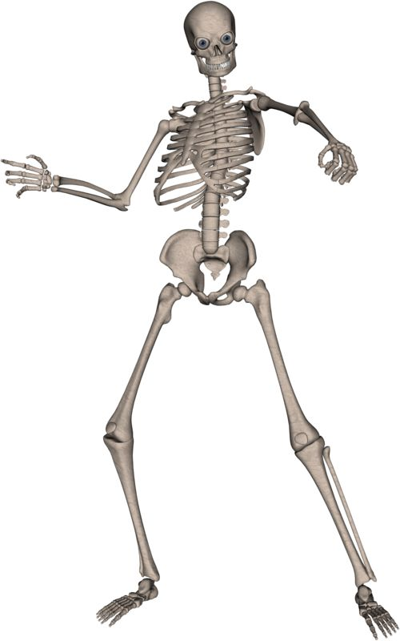
HTML SKELETON:
Inspiration for class: COLT STELEE

